Slide 1











Cryptography
The Science of Secure Information
By: Md. Raihanul Haque March 2023

Slide 2

What is cryptography?
Cryptography is a technique of securing information and communications through the use of codes so that only those persons for whom the data is intended can understand and process it.
In fact, this word gives us this definition if we simply break down the word…
Crypt-o-graphy
The prefix “crypt-” means hidden and the suffix “-graphy” means writing. So, all together it says hidden writing

Slide 3
Basic Terms
Ciphertext
A secret way of writing code. Ciphertext is the encrypted message.
Plaintext A text that is not specially formatted or written in code.
Encode
To convert a message from one system of communication to another.
Encipher
To convert a message into cipher.
Decipher
To convert an enciphered message to it original text.
Decode
To convert a coded message back to its plaintext.

Slide 4


Encryption Ciphertext
Cipher is a method for encrypting messages
Plain Text
(Sender)
Encryption
Algorithm
Cipher Text
Decryption
Algorithm
Plain Text
(Receiver)
Key A
Key B
The key which is an input to the algorithm is secret
Key is a string of numbers or characters
If same key is used for encryption & decryption the algorithm is called symmetric
If different keys are used for encryption & decryption the algorithm is called asymmetric

Slide 5
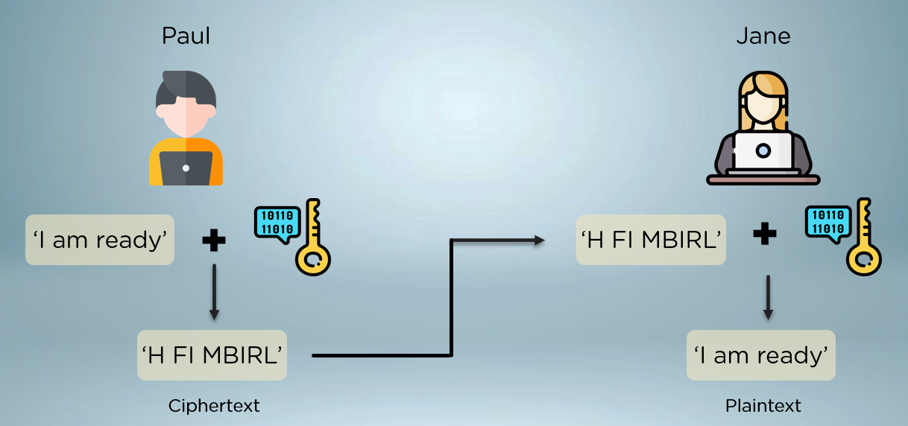
Symmetric Cryptography
Symmetric cryptography uses a single key to encrypt data. Both encryption and decryption in symmetric cryptography use the same key, making this the easiest form of cryptography. Symmetric Key Cryptography is widely used in today's Internet and primarily consists of two types of algorithms, Block and Stream. Some common encryption algorithms include the Advanced Encryption Standard (AES) and the Data Encryption Standard (DES).

Slide 6
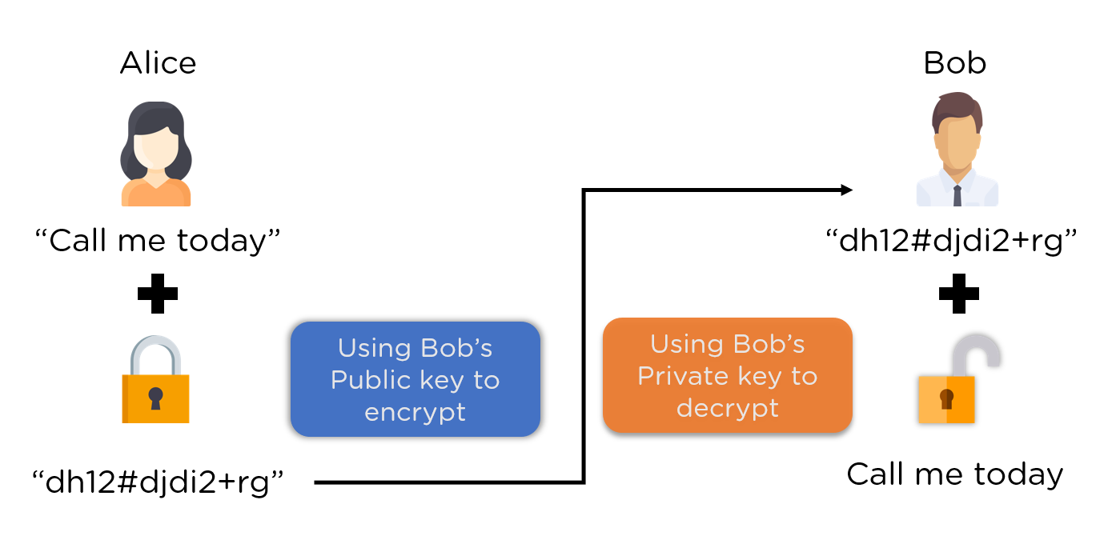
Asymmetric Cryptography
Asymmetric cryptography, uses two keys to encrypt data. One is used for encryption, while the other key can decrypts the message. Unlike symmetric cryptography, if one key is used to encrypt, that same key cannot decrypt the message, rather the other key shall be used. Some asymmetric algorithm are RSA,ECC,EI Gamal.
Alice

Slide 7
Some Dataset of Cryptography
Cryptography involves the use of mathematical algorithms to protect information from unauthorized access or modification. It can be used to secure many types of datasets, including:
Passwords: Passwords are one of the most common types of datasets that require cryptography. Passwords are typically encrypted or hashed before being stored in a database to prevent unauthorized access.
Financial Transactions: Cryptography is used to secure financial transactions, such as credit card transactions or wire transfers. This involves encrypting sensitive financial information, such as account numbers and transaction amounts.
Medical Records: Medical records contain sensitive personal information and are subject to strict privacy regulations. Cryptography is used to protect medical records from unauthorized access and to ensure that only authorized healthcare professionals can access them.
Government Documents: Cryptography is used to protect classified government documents and to secure communication between government agencies.
E-commerce Transactions: Cryptography is used to secure e-commerce transactions, including online purchases and banking transactions. This involves encrypting credit card information and other sensitive data.
Digital Certificates: Digital certificates are used to authenticate the identity of websites and other online entities. Cryptography is used to secure these certificates and to ensure that only authorized parties can issue them.

Slide 8
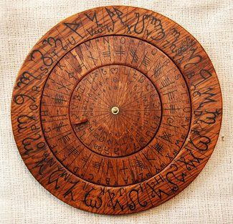
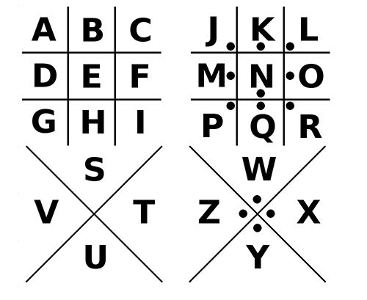
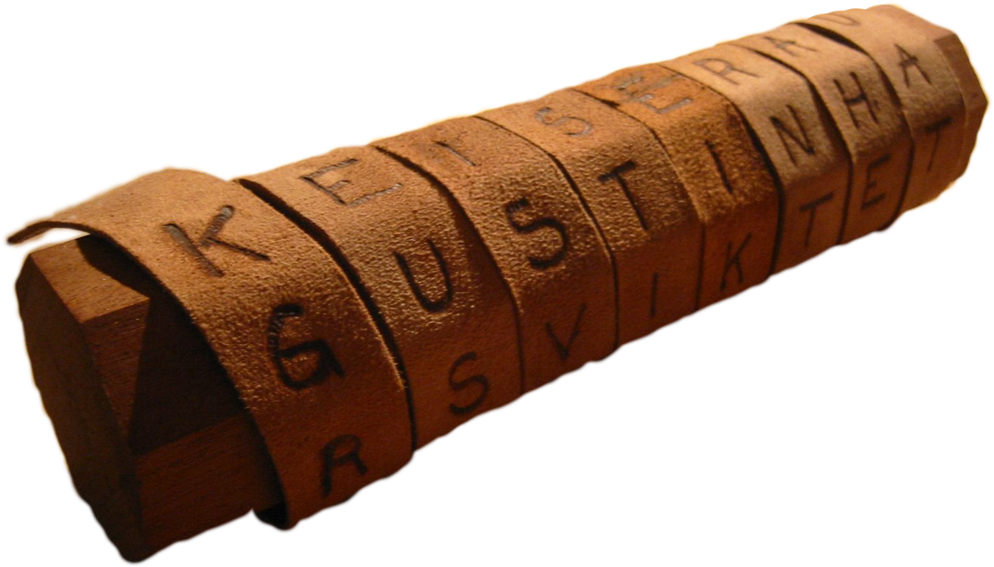
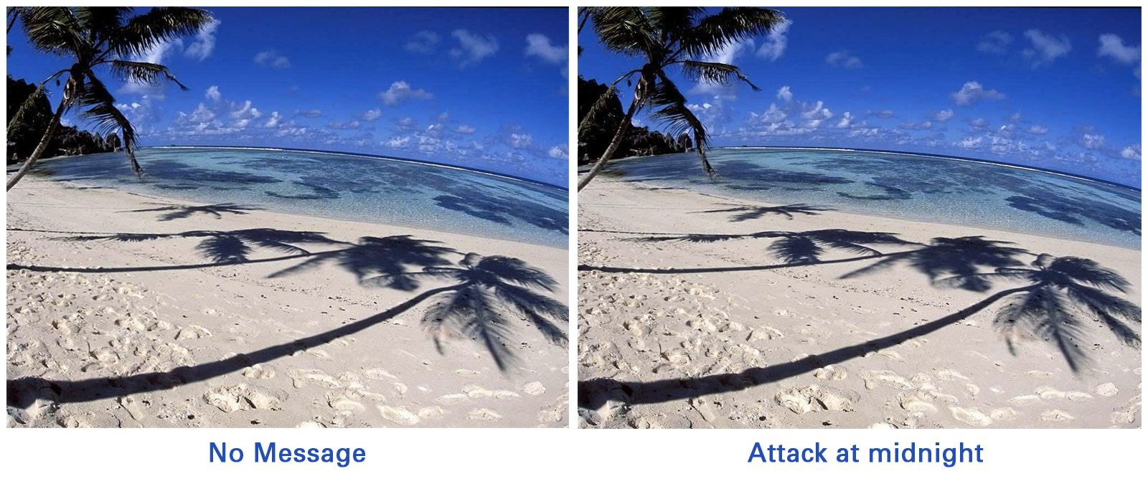
Fun Facts About
Cryptography
In the days of the Roman Empire, encryption was used by Julius Caesar and the Roman Army to cipher text.
Encryption is known to be the easiest and most practical way to protect electronically stored data.
The most popular Cryptographic Techniques include:
The Caesar Cipher
Scytale
Steganography
The Pigpen Cipher

Slide 9
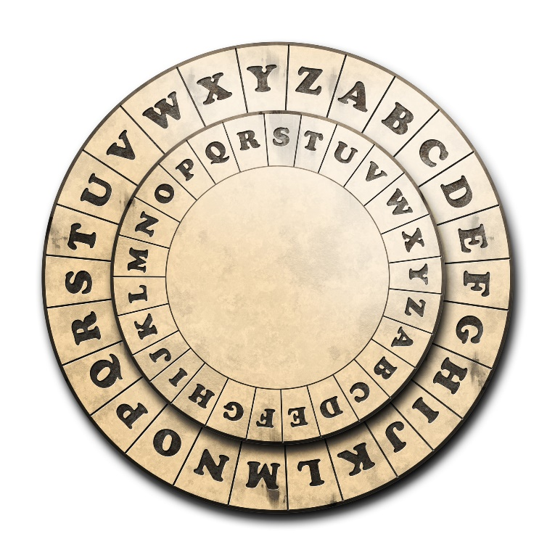
What is the Caesar Cipher?
Caesar Cipher is standard example of ancient cryptography that is said to have been used by Julius Caesar himself. Surprisingly enough, Caesar Cipher is known by many names including the shift cipher, Caesar’s code, and even Caesar shift.

Slide 10
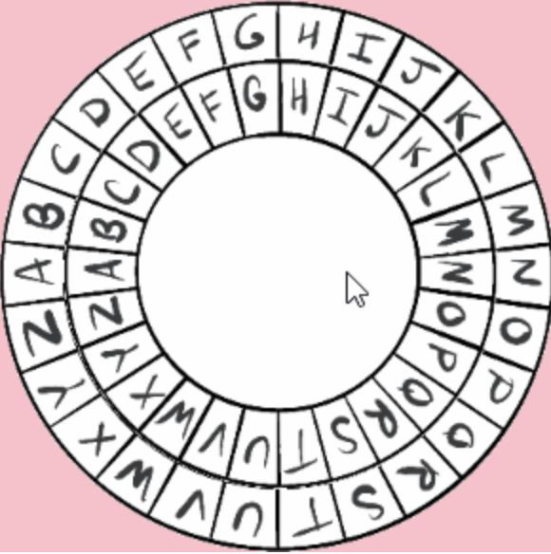
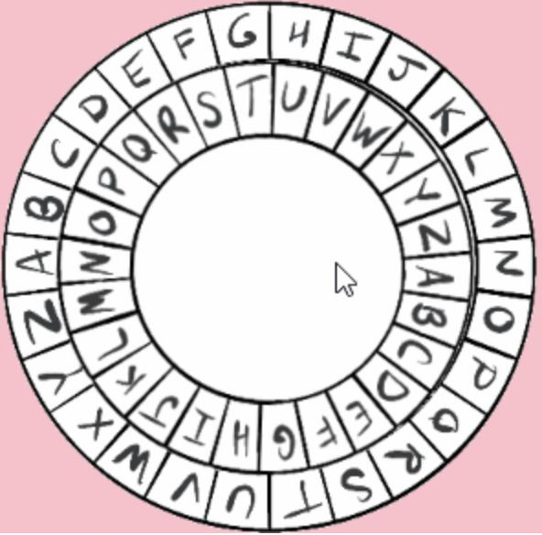
How to Use The Caesar Cipher
This wheel to the right is how we decipher the code. Each letter represents a different number, for example a=0 and then all the way to z which equals 25. These numbers will tell us the shift of the wheel. When you input a certain shift it will take the inner wheel and turn it clockwise in the number of shifts. In the top picture there is no shift, but as we can see in the second picture there is a shift of 11.

Slide 11
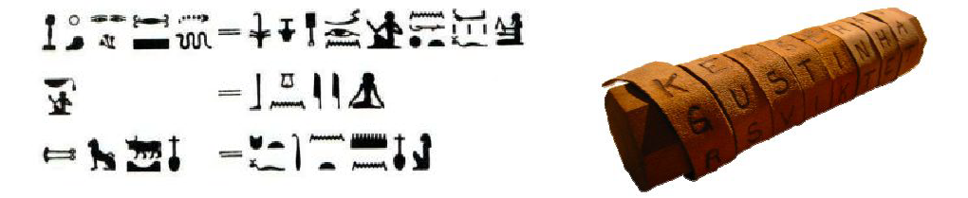
Ancient Cryptography vs. Current Cryptography
Ancient Egypt
In about 1900 B.C., hieroglyphics were introduced to Ancient Egypt. Numbers of unusual symbols obscure the meaning of the symbols, Egyptians did this because they likely that they wished to preserve the pure nature of their religion from common people.
As the Egyptian Culture evolved, hieroglyphic cryptography became more common, this method was relatively easy to translate for those who can read and write. Egyptian Cryptography was used by scribes to impress others by showing that they could write at a higher level.
Ancient Greece and Rome
In about 500 B.C., the Spartans developed a device called Scytale, which was used to send and receive secret messages. In today’s standards, the Scytale would be very easy to decipher, but 2,500 years ago the percentage of people who could read and write was relatively small.
Julius Caesar, who was the commander of the Roman army, solved the problem of secure communication 2000 years ago. Caesar developed a method in which he would substitute letters for different letters. Only those who knew the substitutions could decipher the secret messages, which gave the Roman army a big advantage during the war.

Slide 12
Ancient Cryptography vs Current Cryptography
Ancient Cryptography |  |  |  |  |  | Modern Cryptography
More Complicated Letter Scrambling |  |  |  |  |  | Based on Computational Complexity-the study of what Computer can and can’t do efficiently
Military |  |  |  |  |  | All you need is a working device
Secrecy of protocol algorithm |  |  |  |  |  | Provable security based on mathematics
Requires cryptosystem(aset of algorithms to encode or decode messages securely) for communicating confidentially |  |  |  |  |  | Only requires substitute letter(shift)
Modern cryptography is the cornerstone of computer and communications security. Its foundation is based on various concepts of mathematics such as number theory and probability theory. Cryptography isn’t used for secret messages anymore, it is used as a method of storing and transmitting data in a particular form so that only those for whom it is intended can read and process it. Cryptography not only protects data from theft or alteration but can also be used for user authentication.
From the simple substitution methods of the ancient Greeks to today’s computerized algorithms, various codes and ciphers have been used by both individuals and governments to send secure messages. As an increasing amount of our communications and data have moved online, understanding the underlying ideas of internet security has become increasingly important.

Slide 13
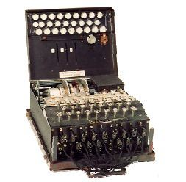
Cryptography Used In World War II
At the end of World War 1, the Enigma was created, an electromechanical machine that was used for the encryption and decryption of secret messages. An Enigma machine allows for billions and billions of ways to encode a message, making it incredibly difficult for other nations to crack German codes during the war — for a time the code seemed unbreakable.
Cracking the Enigma was the single most important victory by the Allied powers during WWII. The allies prevented some attacks, but had to allow some attacks to be carried out to avoid Nazi suspicion they had the insight into German communication despite the fact they had the knowledge to stop them.

Slide 14
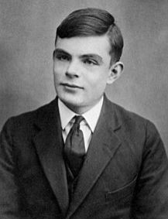
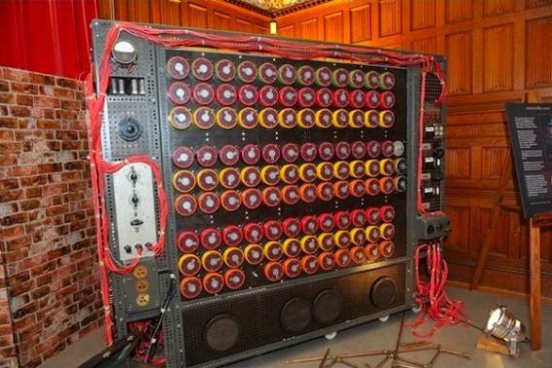
Alan Turing And the bombe machine
Alan Turing designed a machine called the Bombe machine which used electric circuits to solve an Enigma-encoded message. The Bombe machine would try to determine the settings of the rotors and the plugboard of the Enigma machine used to send a given coded message.
Enigma machines typically changed settings every 24 hours. Every day, there were many billions of possible combinations. The Bombe helped Codebreakers discover part of an Enigma key – the settings of the Enigma machine used to encipher a message. Enigma’s rotors and plugboard meant the Germans could use one of many millions of different encryption settings to send their messages.

Slide 15
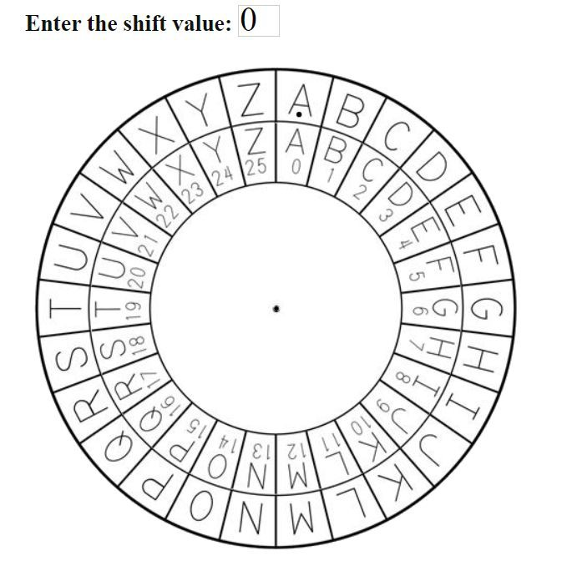
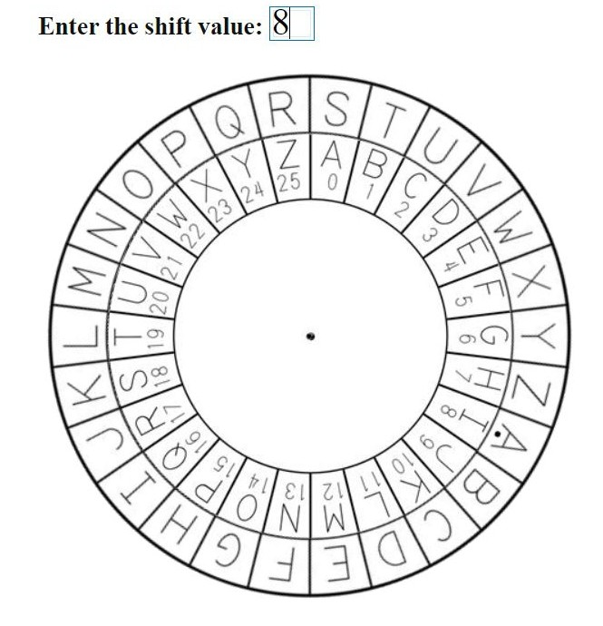
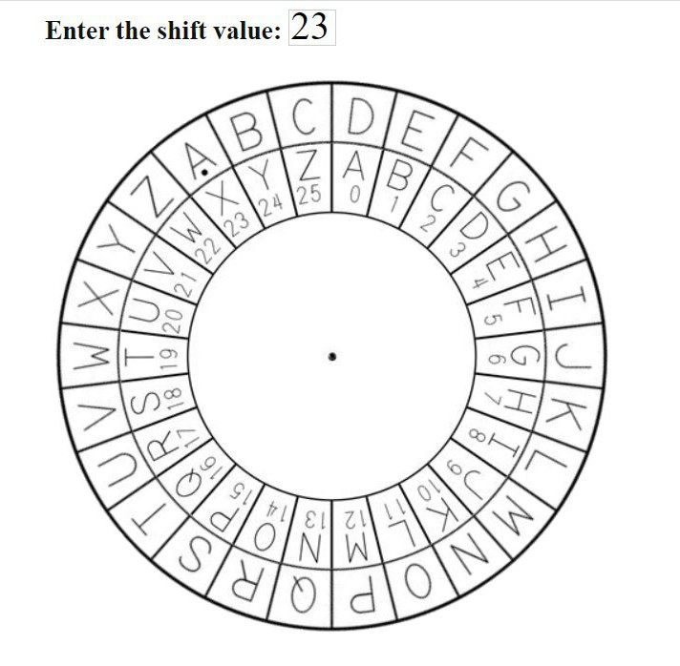
Caesar Cipher Challenge
Encipher Challenge Word - Food
Decipher Challenge Word - DROI
Answer - NWWL
Answer - GURL

Slide 16
Job opportunities in the field of cryptography
Cryptographer: Cryptographers design and develop cryptographic algorithms and protocols to protect data and communications. They work for government agencies, private companies, and research institutions.
Information Security Analyst: Information security analysts are responsible for protecting computer networks and systems from cyberattacks. They use cryptography to secure sensitive data and communications.
Penetration Tester: Penetration testers identify vulnerabilities in computer systems and networks and test them to see if they can be exploited. They use cryptography to try to bypass security measures and gain unauthorized access to systems.
Security Consultant: Security consultants provide advice and guidance to organizations on how to improve their security posture. They use cryptography to recommend solutions for securing data and communications.
Cryptographic Hardware Engineer: Cryptographic hardware engineers design and develop hardware solutions for encryption and decryption. They work for companies that produce cryptographic hardware, such as smart cards and work closely with software engineers and cryptographers.
Cybersecurity Researcher: Cybersecurity researchers study and develop new technologies to improve cybersecurity. They use cryptography to develop new algorithms and protocols for securing data and communications.

Slide 17
Application of Cryptography
Information Security: Cryptography is used to secure information transmitted over the internet, including emails, credit card information, and online transactions. This ensures that the information is only accessible to the intended recipient.
Digital Signatures: Cryptography is used to create digital signatures, which are used to verify the authenticity of digital documents. This is useful in financial transactions, legal contracts, and other situations where the authenticity of a document is critical.
Passwords: Cryptography is used to store and transmit passwords securely. This prevents unauthorized access to sensitive information.
Military and Government: Cryptography is used extensively by military and government agencies to secure communication and information.
E-commerce: Cryptography is used to secure e-commerce transactions, ensuring that credit card information and other sensitive data are protected.
Blockchain: Cryptography is used in blockchain technology to secure transactions and ensure the integrity of the blockchain ledger.

Slide 18
VPNs: Virtual Private Networks (VPNs) use cryptography to create a secure tunnel for data transmission between two endpoints over an untrusted network like the internet. This ensures that the data transmitted between the two endpoints is protected from interception and tampering.
Secure Messaging: Encrypted messaging apps like WhatsApp, Signal, and Telegram use cryptography to secure their users' communication. The encryption ensures that only the intended recipient can read the messages and that the messages can't be intercepted by third parties.
Data Protection: Cryptography is used to protect data at rest, such as on hard drives or in databases. This is important for businesses and organizations that need to store sensitive data, such as financial records, medical records, and personal information.
Password Recovery: Password recovery mechanisms like password reset emails or SMS messages use cryptography to ensure that only the rightful owner of the account can reset the password. This prevents unauthorized access to the account by a third party who has access to the user's email or phone.
Digital Rights Management: Digital Rights Management (DRM) technologies use cryptography to protect digital content, such as movies, music, and e-books, from unauthorized copying and distribution. This ensures that the creators and distributors of the content can control its distribution and monetization.

Slide 19
One Related Research paper
"The Security of the Cipher Block Chaining Message Authentication Code" by Mihir Bellare and Phillip Rogaway(2005).
Problem Statements:- Is the CBC-MAC (Cipher Block Chaining Message Authentication Code) Secure?
Inputs Datasets:- The paper presents a theoretical analysis of the security of the CBC-MAC construction and proposes an improved construction called "CMAC". The analysis is based on mathematical proofs and simulations, rather than on any specific input dataset.

Slide 20
The key methods used in the paper
Mathematical analysis: The authors use mathematical concepts and techniques to analyze the security of the CBC-MAC construction and to identify its vulnerabilities. They use concepts from probability theory and cryptography to analyze the behavior of the construction under different attack scenarios.
Simulation: The authors also use simulation techniques to test the security of the CBC-MAC construction and the proposed modifications. They simulate different attack scenarios and evaluate the effectiveness of the construction and its modifications under these scenarios.
Cryptographic proofs: The authors provide formal cryptographic proofs to demonstrate the security of the proposed modifications to the CBC-MAC construction. They use a rigorous mathematical approach to demonstrate that the modifications provide provably secure message authentication.
Case studies: The authors also provide several case studies to illustrate the practical implications of the proposed modifications to the CBC-MAC construction. They provide examples of how the modifications can be used in real-world applications and how they can improve the security of message authentication.

Slide 21
Outcomes of this Research
Analysis of CBC-MAC: The paper provided a detailed analysis of the security of the Cipher Block Chaining Message Authentication Code (CBC-MAC) construction. The authors identified several vulnerabilities in the construction, particularly related to length extension attacks.
Proposed modifications to CBC-MAC: The authors proposed modifications to the CBC-MAC construction to address its vulnerabilities. The proposed modifications are called "CMAC" and they are designed to be resistant to length extension attacks.
Security proofs for CMAC: The authors provided formal cryptographic proofs to demonstrate the security of the proposed modifications to the CBC-MAC construction. These proofs demonstrate that CMAC provides provably secure message authentication.
Improved security for message authentication: The proposed modifications to the CBC-MAC construction improve the security of message authentication in real-world applications. This can help to prevent unauthorized access to sensitive data and protect against attacks such as data tampering and replay attacks.
Influence on cryptographic standards: The CMAC construction proposed in the paper has been incorporated into several cryptographic standards, including the National Institute of Standards and Technology (NIST) standard for message authentication codes. The paper has therefore had a significant impact on the development of cryptographic standards and practices.

Slide 22
Thank you everyone
Presented by-
Md. Raihanul Haque
ID: 200129

